Slide 1


LEARN TO NAVIGATE:
LARIAN GAMES

Slide 2
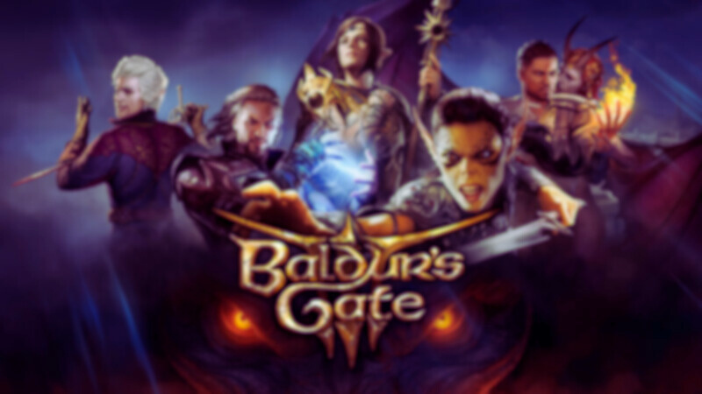
Baldur’s Gate 3 is a modern role playing game utilizing Dungeons and Dragons 5th Generation Rules in an action/strategy environment.

Slide 3
The User Interface for this game is notoriously clunky, overwhelming, and not user-friendly. This tour will help you get your head around the UI!

Slide 4
The UI is different when using a mouse/keyboard versus a controller. First, we’ll go over the mouse/keyboard set up.

Slide 5

mouse and keyboard

Slide 6
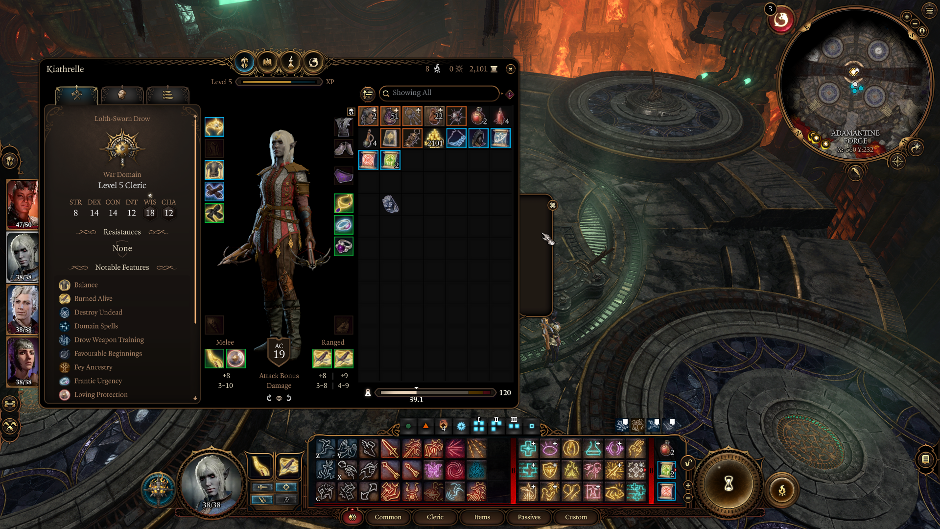
“equipped” inventory items
mini Map
party List
Selected character’s inventory
Actions include “common” actions such as jump, shove, attack (ranged or melee), throw, etc.
available actions
They can also include spells, potions, or other items that have been placed in a shortcut for easy access outside of the inventory.
active character
DETAILED CHARACTER INFORMATION
end turn (hour glass) and rest (camp fire)

Slide 7
Mouse/KB Tips & Tricks:
Gamers familiar with “drag and drop” RPGs will feel at home using the mouse/kb.
Hover over an item or action to learn more about it.
This actions/shortcut interface is much more streamlined than the controller UI.

Slide 8

controller

Slide 9
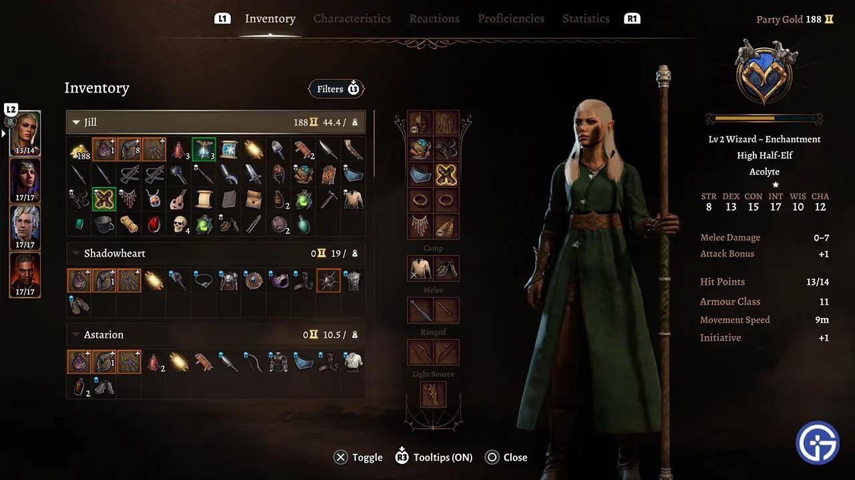
entire party inventory
party List
“equipped” inventory items
detailed character information

Slide 10
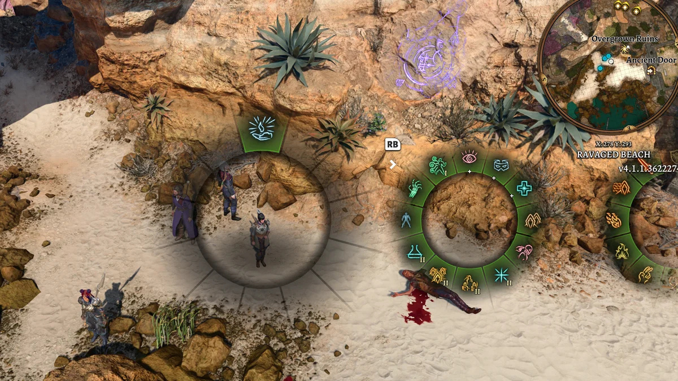
These are the action/shortcut menus, presented as radial menus, similar to what other games use (think GTA V or Red Dead Redemption.)
These are activated by the left or right bumper buttons.
They are not widely loved by the community, but they get the job done.

Slide 11
Controller Tips & Tricks:
Arranging actions and shortcuts can be a hassle (though deep in the options menu is a way to automatically add items or actions to the radial menus)
Detailed character information requires scrolling through multiple menus
Clicking the right joystick allows you to enable/disable tooltips or item comparisons versus hovering over them with the mouse

Slide 12

GET OUT THERE AND CONQUER FAERUN!

